Slide 1

Unit-3 Indexes, Query Optimization and Performance Tuning
Database Management System - II
#2301CS401
Prof. Dixita B. Kagathara
Computer Engineering Department
dixita.kagathara@darshan.ac.in
+91 - 97277 47317 (CSE Department)

Slide 2

Looping
Outline
Overview of Indexes
Types of Indexes
Clustered v/s Non-Clustered Index
Execution Plans
Missing Index
Warning Understanding
Do's & Don'ts While Writing a Query
Table Variable
Temporary Table
Global Table

Slide 3
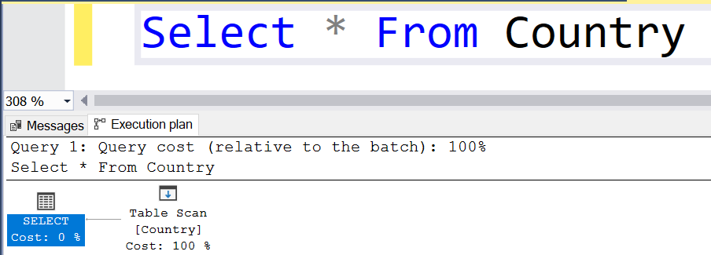
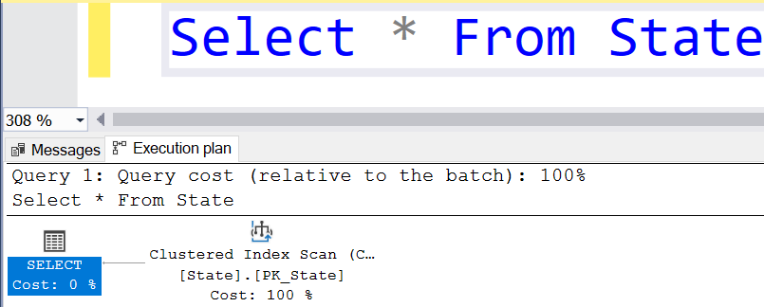
How will the database engine retrieve the data from a table in SQL Server?
Whenever the database engine wants to retrieve the data from a database table it will adopt two different mechanisms for searching the data
Table scan
Index Scan/Seek

Slide 4
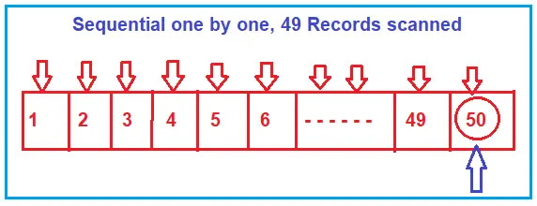
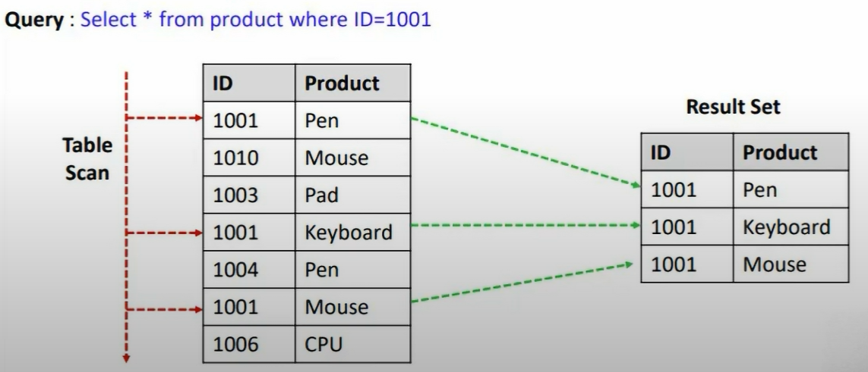
What is Table Scan in SQL Server?
In Table Scan, the SQL Server Search Engine will search for the required information sequentially one by one from the start to the last record of the table.
Suppose, you want to search the value 50, then the search engine will scan the record sequentially one by one from the beginning i.e. from 1, and until it reaches the value 50.
If the table has more rows, then it will take more time for searching the required data, so it is a time-consuming process.
When there is no index in the table, SQL Server searches the data sequentially.
To minimize the scans, B-Tree (Balanced Tree) is used.

Slide 5
What is Index Scan/Seek in SQL Server?
Index Scan uses a B-Tree structure to efficiently search for required data.
B-Tree structure drastically improves the performance of your search query by reducing the number of scans.
So, let us first understand what B-Tree structure is and how it reduces the number scan which ultimately improves the performance of your search query.

Slide 6
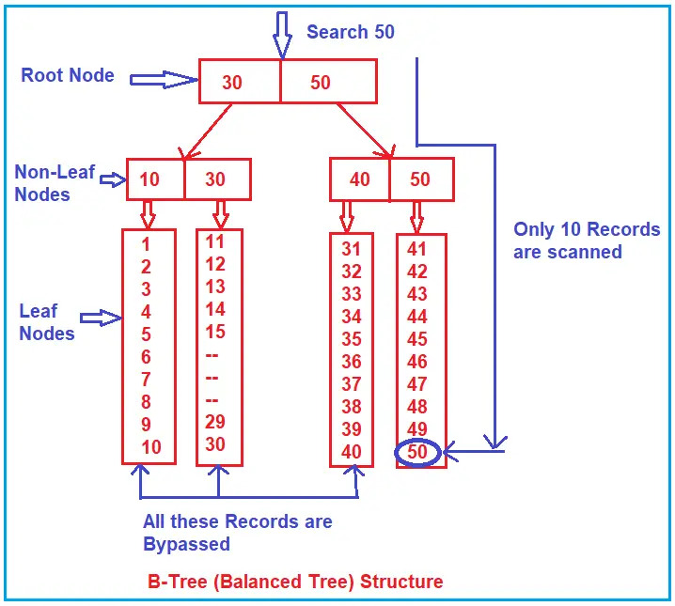
Understanding the Balanced Tree (B-Tree) in SQL Server:
Whenever you create an index on some column(s), SQL Server internally creates a B-Tree structure.
B-Tree Structure: Divides data into three levels – Root Node, Non-Leaf Nodes, and Leaf Nodes.
Root Node: Contains key values (e.g., 30, 50) that direct the search.
Non-Leaf Nodes: Further divide the data for efficient navigation (e.g., 10, 30, 40, 50).
Leaf Nodes: Store actual data and serve as pointers to table rows.

Slide 7
Understanding the Balanced Tree (B-Tree) in SQL Server:
Search Process for 50:
Starts at Root Node
Checks if 50 ≤ 30 (Fails)
Moves to Node 50 (Matches)
Goes to Non-Leaf Nodes (40, 50)
Bypasses 40 since 40 < 50.
Reaches Leaf Node 50
Now, scans sequentially, and retrieves the record efficiently.
Efficiency: Only 10 records are scanned, skipping unnecessary records for faster lookups.
This indexing approach enhances query performance by reducing the number of records scanned.

Slide 8
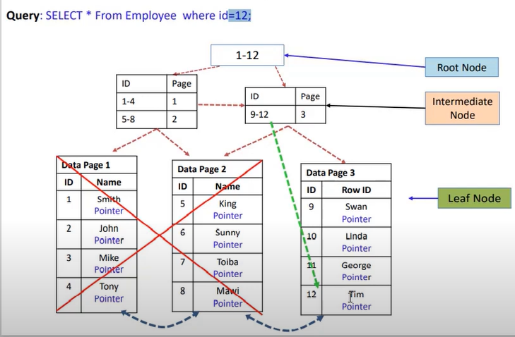
Example

Slide 9
Indexes

Slide 10
Indexes : Introduction
SQL Indexes are used in relational databases to quickly retrieve data.
They are similar to indexes at the end of the books whose purpose is to find a topic quickly.
Data in a table is stored in rows in an unordered structure called Heap.
If you have to fetch data from a table, the query optimizer has to scan the entire table to retrieve the required row(s).
If a table has a large number of rows, then SQL Server will take a long time to retrieve the required rows.
So, to speed up data retrieval, SQL Server has a special data structure called indexes.
An index is mostly created on one or more columns which are commonly used in the SELECT clause or WHERE clause.

Slide 11
Types of Indexes
SQL Server supports two types of indexes:
Clustered Index
Non-Clustered Index

Slide 12
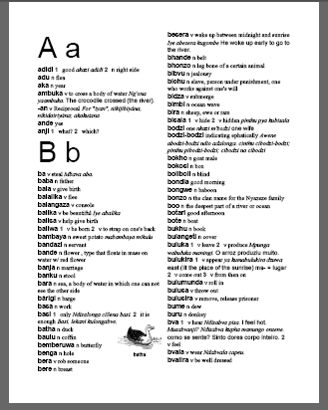
Clustered Index
Clustered indexes define the way records are physically sorted in a database table.
A clustered index is very similar to the Dictionary.
Records can either be sorted by their ids (in table) or they can be sorted by the alphabetical order of some string column or any other criteria.
However, you cannot have records physically sorted by ids as well as names (in real world scenario).
Hence, there can be only one clustered index for a database table and it is called as clustered index.
If a table already has a clustered index, trying to create another one will result in an error.

Slide 13
Syntax: Clustered Index
Syntax to create a clustered index in SQL Server :
CREATE CLUSTERED INDEX <index_name>
ON <table_name>(<column_name> ASC/DESC)
Syntax to drop a clustered index in SQL Server:
DROP INDEX <index_name> ON <table_name>

Slide 14
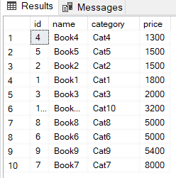
Example: Clustered Index
Let’s create clustered index on price column of the Book table.
CREATE CLUSTERED INDEX IX_BUK_Book_Price
ON Books (Price ASC)
This clustered index physically sorts all the records in the Books table by the ascending order of the price.
Select * From Books
Select * From Books
Where price >=5000

Slide 15
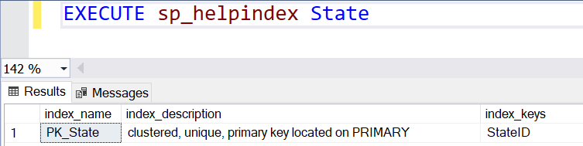
Default Clustered Index
A database table has one clustered index by default on the primary key column.
To see the default index, you can use the sp_helpindex stored procedure as shown below:

Slide 16
Clustered Indexes of Database
In SQL Server, there is a system table with the name sys.indexes that contains information about indexes are available on tables into the database.
Select * From Sys.indexes
Where Name like 'PK%’
Columns of the sys.indexes table determine whether or not the column on which you write the conditions has an index.

Slide 17
When NOT to Use a Clustered Index?
On Frequently Updated Columns
Columns such as Salary, LastLoginTime are frequently updatable columns.
Updating indexed columns causes data page reorganizations.
When Table has Frequent Insertions at Random Positions.
A log table with LogID as a non-sequential value.

Slide 18
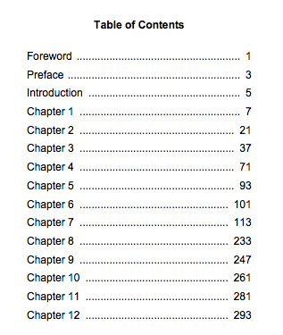
Remember!!
Clustered Index
Non-Clustered Index

Slide 19
Non-clustered Index
A non-clustered index is an index that doesn’t physically sort the database records.
Non-clustered index is actually similar to an index of a book.
A book's index is kept at separate location, and the book's actual text is kept at other location.
The index creates a separate lookup table that contains the indexed column and a pointer (Row Locator) to the actual data.
The index table will have pointers to the storage location of the actual data.
If a query searches for data using a non-clustered index, SQL Server first searches the index and then retrieves the actual data row using the pointer.

Slide 20
Syntax: Non-clustered Index
Syntax to create a non clustered index in SQL Server :
CREATE NONCLUSTERED INDEX <index_name>
ON <table_name>(<column_name> ASC/DESC)
Syntax to drop a non clustered index in SQL Server:
DROP INDEX <index_name> ON <table_name>

Slide 21
Example-1: Non-clustered Index
Example:
CREATE NONCLUSTERED INDEX IX_Employees_LastName
ON Employees(LastName);
A non-clustered index is logically sorted based on the indexed column(s), but it does not change the physical order of the data in the main table.
Searching in a logically sorted non-clustered index is faster than scanning an unsorted table.
EmployeeID (PK) | FirstName | LastName | Department | Salary
101 | Alice | Brown | IT | 60000
102 | Bob | Smith | HR | 55000
103 | Charlie | Davis | IT | 62000
104 | David | Johnson | Sales | 50000
105 | Emma | Wilson | HR | 53000
LastName | Pointer (EmployeeID)
Brown | 101
Davis | 103
Johnson | 104
Smith | 102
Wilson | 105

Slide 22
Example-1: Non-clustered Index
Query: SELECT * FROM Employees
WHERE LastName = ‘Smith’;
SQL Server performs a binary search on the logically sorted index to locate ‘Smith’
It finds ‘Smith’ in the index and retrieves the pointer (EmployeeID = 102).
Now that SQL Server has EmployeeID = 102, it jumps to the main Employees table and uses clustered index to retrieves the full row.
EmployeeID (PK) | FirstName | LastName | Department | Salary
101 | Alice | Brown | IT | 60000
102 | Bob | Smith | HR | 55000
103 | Charlie | Davis | IT | 62000
104 | David | Johnson | Sales | 50000
105 | Emma | Wilson | HR | 53000
LastName | Pointer (EmployeeID)
Brown | 101
Davis | 103
Johnson | 104
Smith | 102
Wilson | 105

Slide 23
Example-2: Non-clustered Index
Now anyone searches for StateName, StateID & Code for a specific state, the database will first search the state’s name in the non-clustered index.
Once the state name is searched, the StateID & Code of the state are searched from the actual table using the record address.
This extra lookup step is why non-clustered indexes are slightly slower than clustered indexes for retrieving full rows but improve performance for searches on non-primary key columns.
StateName | Record Addresses
Gujarat | Record address
Rajasthan | Record address
Maharastra | Record address
Karachi | Record address
Islamabad | Record address

Slide 24
Non-clustered Index
You can create a maximum of 999 non-clustered indexes on a table, which is 254 up to SQL Server 2005.
A non-clustered index is also maintained in a B-Tree data structure but leaf nodes of a B-Tree of non-clustered index contains the pointers to the pages that contain the table data.

Slide 25
Clustered v/s Non–Clustered Index
Parameters | Clustered Index | Non – Clustered Index
Definition | Sorts and stores the actual table data in a specific order. | Stores only indexed columns + pointers to actual rows.
Storing method | Data rows are physically arranged based on the index key | Creates a separate structure storing index values and pointers
Size | The size of the clustered index is quite large. | The size of the non-clustered index is small compared to the clustered index.
Data accessing | Faster | Slower compared to the clustered index
Additional disk space | Not Required | Required to store the index separately
Type of key | By Default Primary Keys Of The Table is a Clustered Index. | It can be used with unique constraint on the table.
Main feature | A clustered index can improve the performance of data retrieval. | It should be created on columns which are used in joins.

Slide 26
Execution Plan

Slide 27
Introduction : Execution Plan
Being a Data Professional, it is very essential that we must understand how to write efficient queries that return faster results.
An Execution Plan in SQL Server is a detailed roadmap that shows how a query will be executed by the SQL Server Query Optimizer.
An execution plan in SQL Server is a simple graphical representation of the operations that the query optimizer generates to calculate the most efficient way to return a set of results.
An Execution Plan provides insights into how SQL Server retrieves or modifies data.
It helps developers and DBAs analyze query performance and optimize it.

Slide 28
Why is the Execution Plan Important?
Helps identify performance bottlenecks in queries.
Shows whether SQL Server is using Index Scan, Index Seek, Table Scan, etc.
Helps in query tuning and indexing decisions.
Assists in debugging slow-running queries.

Slide 29
Types of Execution Plan
There are two types of execution plans
Estimated Execution Plan
As the name suggests, this type of execution plan is just a guess by the query processor about how the specific steps that are to be involved while returning the results.
It is often generated before the query has been executed.
Shows how SQL Server intends to execute the query before actually running it.
Does not consider runtime factors like actual row counts.
Useful for analyzing performance without executing the query (good for costly queries).
Actual Execution Plan
Displays the real execution process after running the query.
The Actual Execution Plan is generated after the query has been executed.
It shows the actual operations and steps involved while executing the query, Helps to identify performance bottlenecks like expensive operations.
Includes real runtime statistics, such as actual row counts and execution time.
This may or may not differ from the Estimated Execution Plan.

Slide 30
Example Query and Possible Execution Plan
Query:
SELECT * FROM Books WHERE price >= 5000;
Possible Execution Plan Results:
If price has no index → Table Scan (Slow)
If price has a non-clustered index → Index Seek (Faster)
If price is a clustered index → Clustered Index Seek (Most Efficient)

Slide 31
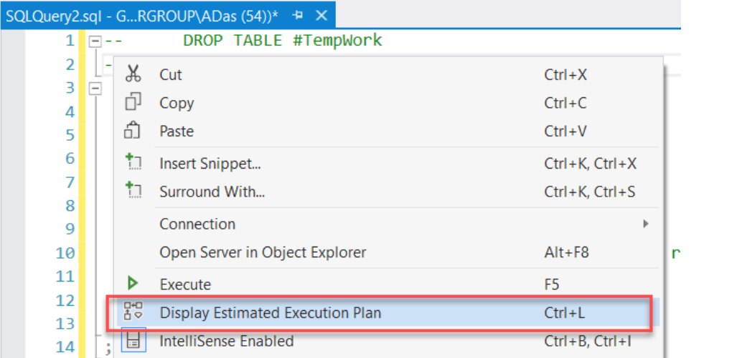
How to generate Estimated Execution Plans?
The Execution Plans in SQL Server can be generated before and after the query has been executed.
There are several ways to get the estimated execution plan in SQL Server.
Once the query is written completely, you can hit “Ctrl + L” and it will generate the estimated execution plan.
You can also right-click on the query window and select “Display Estimated Execution Plan” from the context menu that appears.

Slide 32
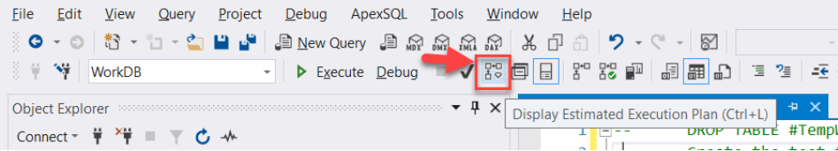
How to generate Estimated Execution Plans?
Alternatively, you can directly click the “Display Estimated Execution Plan” icon which is available on the toolbar in SQL Server Management Studio

Slide 33
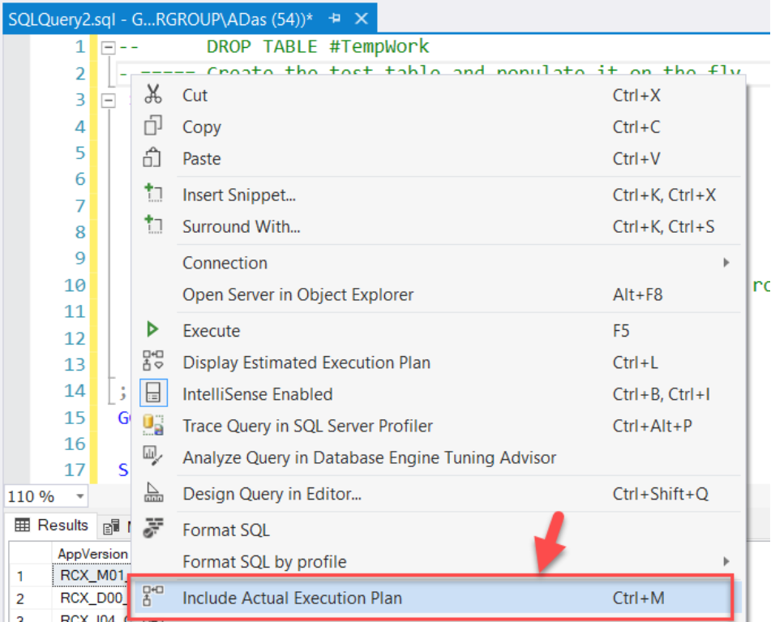
How to generate Actual Execution Plans?
Hit “Ctrl + M” and it will generate the actual execution plan after the query has been executed successfully.
Right-click on the query window and select “Display Actual Execution Plan” from the context menu

Slide 34
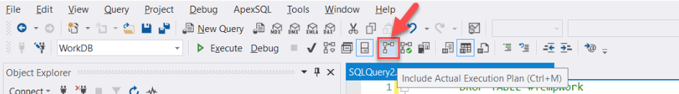
How to generate Actual Execution Plans? Cont..
Alternatively, you can directly click the “Display Actual Execution Plan” icon which is available on the toolbar in SQL Server Management Studio

Slide 35
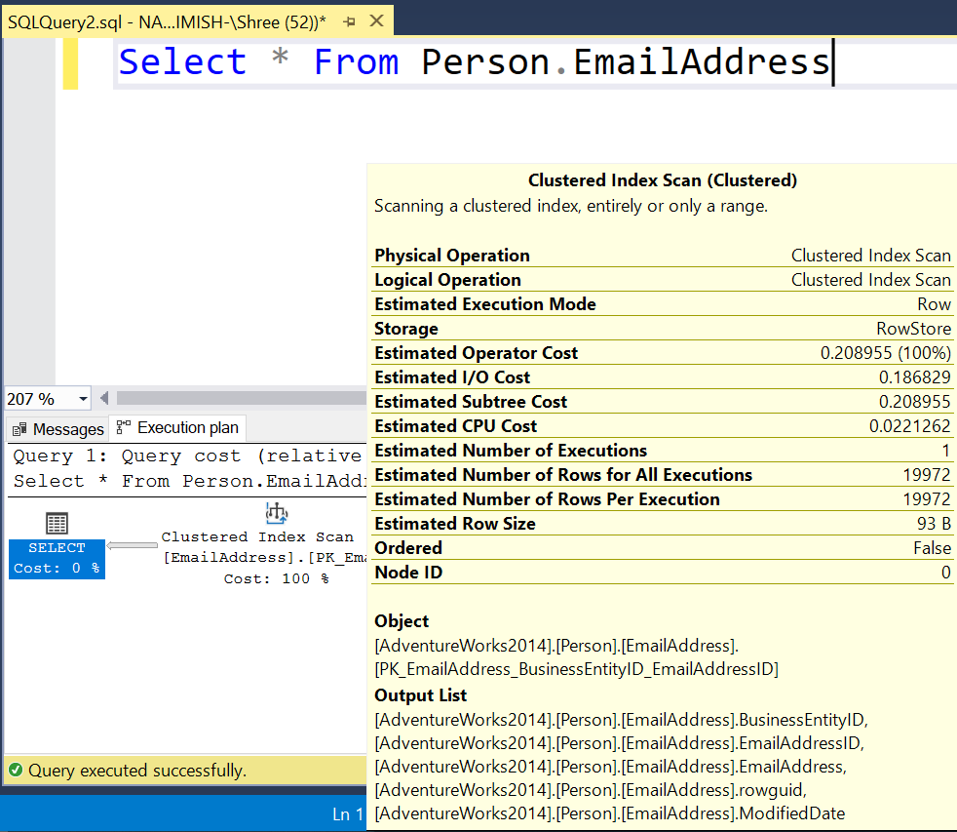
1. Estimated Execution Plan - Example
Write only query and press “CTRL + L”
Do not press F5 or Execute Button

Slide 36
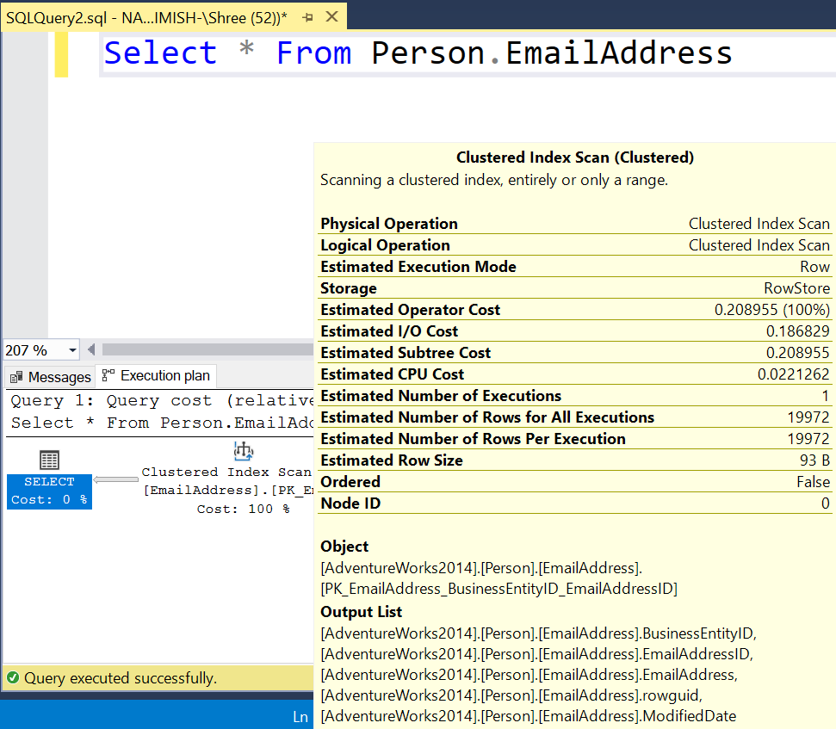
2. Actual Execution Plan
After pressing F5 or Execute Button

Slide 37
Estimated = Actual
Estimated
Actual

Slide 38
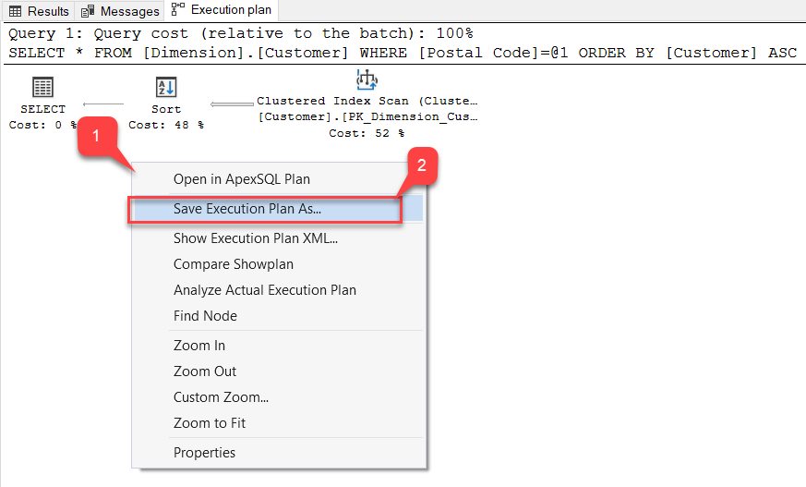
Saving an Execution Plan in SQL Server Management Studio
Sometimes, it is essential that after interpreting the plan generated by the query, you might want to save if for future references.
SQL Server Management Studio provides an option to save the plan in the file system with an extension of “.sqlplan“.

Slide 39
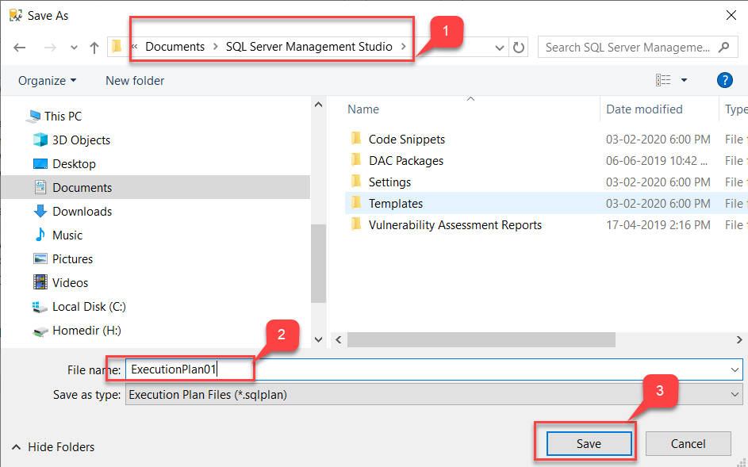
Saving an Execution Plan in SQL Server Management Studio

Slide 40
Warning Understanding

Slide 41
1. Missing Index Warning
What It Is: SQL Server warns when a query could benefit from a missing index. This means that SQL is performing a full table scan, which could be avoided with the right index.
How to Spot It: It typically appears in the Execution Plan as a recommendation to create an index.
Example:
SELECT * FROM Orders WHERE CustomerID = 1;
Fix: Create an index on CustomerID to improve performance.
CREATE INDEX idx_CustomerID ON Orders(CustomerID);
Improve performance by creating indexes on frequently queried columns.

Slide 42
2. Table Scan Warning
What It Is: A table scan happens when SQL Server reads every row in a table to fulfill a query because no efficient index is available.
How to Spot It: You'll see a Table Scan or Clustered Index Scan in the query execution plan.
Example:
SELECT * FROM Orders WHERE OrderAmount > 5000;
Fix: Create indexes on columns used in filters (like OrderAmount).
CREATE INDEX idx_OrderAmount ON Orders(OrderAmount);
Avoid full table scans by creating indexes on columns used in WHERE clauses.

Slide 43
3. Implicit Conversion Warning
What It Is: This warning occurs when SQL Server has to automatically convert data types in the query, which can slow down execution.
How to Spot It: SQL Server issues a warning in the execution plan if a column and value being compared have different data types.
Example:
SELECT * FROM Orders WHERE OrderAmount = '100';
Fix: Use matching data types in the query.
SELECT * FROM Orders WHERE OrderAmount = 100; -- Numeric value instead of a string
Ensure matching data types in queries to avoid unnecessary conversions.

Slide 44
4. Non-SARGable Queries
What It Is: A non-SARGable (Search Argument Able) query means that the query can’t use indexes efficiently, often because of functions applied to indexed columns.
How to Spot It: You may notice full table scans and poor performance.
Example:
SELECT * FROM Orders WHERE YEAR(OrderDate) = 2024;
Fix: Modify the query to avoid applying functions to columns being filtered.
SELECT * FROM Orders WHERE OrderDate>='2024-01-01' AND OrderDate<'2025-01-01';
Avoid using functions on columns being filtered to make the query index-friendly.

Slide 45
5. Out of Memory Warning
What It Is: This warning happens when SQL Server runs out of memory while executing a query.
How to Spot It: SQL Server may issue an error or performance degradation could be observed.
Example:
SELECT * FROM LargeTable WHERE SomeColumn = 'SomeValue’;
Fix: Break large queries into smaller ones or optimize the query to limit the amount of data processed at once.
Break large queries into smaller parts or optimize memory usage.

Slide 46
6. Join Without Index Warning
What It Is: This warning appears when SQL Server doesn’t find an index to optimize the join between two tables.
How to Spot It: You'll see inefficient execution plans (like Nested Loop Joins without indexes).
Example:
SELECT * FROM Orders o
JOIN Customers c ON o.CustomerID = c.CustomerID;
Fix: Ensure that there are indexes on the join columns
CREATE INDEX idx_ OrderID_Orders ON Orders(OrderID);
CREATE INDEX idx_CustomerID_Customers ON Customers(CustomerID);
Ensure that joining columns have indexes to speed up joins.

Slide 47
7. Group By and Sorting Warning
What It Is: SQL Server may issue warnings related to inefficient GROUP BY or ORDER BY operations that lack suitable indexes.
How to Spot It: This can lead to slow query performance, especially when large datasets are involved.
Example:
SELECT CustomerID, COUNT(*) FROM Orders GROUP BY CustomerID;
Fix: Create appropriate indexes on the grouping column (CustomerID).
CREATE INDEX idx_CustomerID ON Orders(CustomerID);
Index columns involved in grouping and sorting to optimize query performance.

Slide 48
8. Missing Statistics Warning
What It Is: SQL Server uses statistics to estimate the distribution of values in a column, helping it decide:
Which indexes to use
Whether to use an index seek or scan
How to optimize joins & filters
If statistics are missing or outdated, SQL Server might choose a bad execution plan, causing slow performance.
If you run a query in SSMS with Include Actual Execution Plan (Ctrl + M), you might see:
⚠️ "Missing Statistics"⚠️ "Outdated Statistics"
How to Spot It: SQL Server may show a warning about missing statistics for certain columns.
Example:
SELECT * FROM Orders WHERE OrderAmount > 500;
Fix: Update statistics on the relevant table or column.
UPDATE STATISTICS Orders; (Regularly update statistics to optimize query plans)

Slide 49
9. Parallelism Warning
What It Is: SQL Server might attempt to parallelize a query, but sometimes it can slow things down instead of speeding them up.
How to Spot It: You'll see parallel plan operators in the execution plan, like Parallelism (Gather Streams).
Example:
SELECT * FROM Orders WHERE OrderAmount > 100;
Fix: Limit parallelism using OPTION (MAXDOP 1) to use only one processor.
SELECT * FROM Orders WHERE OrderAmount > 100 OPTION (MAXDOP 1);
Control parallelism when necessary to prevent performance degradation.

Slide 50
Do's & Don'ts While Writing a Query (Query Optimization)

Slide 51
Query Optimization
Query optimization is the process of improving SQL queries in:
Better performance
Lower execution time
Reduced resource usage (CPU, memory, and I/O).
SQL performance tuning can be an incredibly challenging task, especially when working with large-scale data where even the smallest change can have a dramatic performance effect, positively or negatively.

Slide 52
1. Use of Varchar instead of Char Data Type
CHAR(n): Fixed-length, always takes n bytes (pads spaces if shorter).
Example: CHAR(100) takes 100 bytes even if storing 1 character.
VARCHAR(n): Variable-length, stores only actual data length + 2 bytes overhead.
Example: VARCHAR(100) takes 1 byte for a single character.
Memory Efficiency → VARCHAR is more efficient than CHAR as it avoids unnecessary padding.
Usage → Use CHAR only for fixed-length data (e.g., country codes, PAN number), VARCHAR for variable-length data (e.g., names, descriptions).

Slide 53
2. SELECT fields, rather than using SELECT *
Use the SELECT statement optimally, instead of always fetching all data from the table.
Fetch only the necessary data from the table, thereby avoiding the costs of transferring unwanted data and processing it.
Inefficient
SELECT * FROM Business
Efficient
SELECT CustName, Phone, C_Address, CompanyZip FROM Business
This query is much simpler, and only pulls the required details from the business table.

Slide 54
3. Avoid DISTINCT in SELECT query
SELECT DISTINCT is a simple way of removing duplicates from a database.
SELECT DISTINCT works to generate distinct outcomes by using the GROUP BY clause, which groups all the fields in the query.
However, a large amount of processing power is required to do this. So, avoid DISTINCT in SELECT queries if not required.
Inefficient
SELECT DISTINCT FName, LName, Country FROM Customers
Multiple people in the same country might have the same first and last name.
Efficient
SELECT ID, FName, LName, Country, State, City, Zip FROM Customers
Unduplicated records are returned without using SELECT DISTINCT by adding more fields.

Slide 55
4. Be aware of NULL in your results
A field with a NULL value is a field with no value.
If a field in a table is optional, it is possible to insert a new record or update a record without adding a value to this field.
Then, the field will be saved with a NULL value.
Note: A NULL value is different from a zero value or a field that contains spaces.
Inefficient
Select 1 + NULL
Answer will be NULL, but in real world this is wrong because many columns with having null values and when you do any operation on it then result will be null.
Efficient
Select 1 + ISNULL(NULL,0)
Answer will be 1. Replaces NULL with the specified value.

Slide 56
5. Do not include column numbers in ORDER BY
The main purpose of using this is for usability and scalability and not just performance.
When you use ColumnNumber, then the results will be unpredictable and wrong in terms of ORDER BY.
Inefficient
Select StateName, StateCode, Remarks From State Order By 1,2
This will perform order by with column sequence of your table.
Efficient
Select StateName, StateCode, Remarks From State Order By StateCode, StateName
Always write column names in order by instead of numbers.

Slide 57
6. Prefix for stored procedures should not that starts with “sp_”
Do not use a prefix for stored procedures that starts with “sp_”.
Reason: sp_ is reserved for system stored procedures in SQL Server
It is advised to follow a unique pattern to name procedures that can be differentiated easily.
It helps to avoid Performance issue and Naming conflicts
Because system procedures also starts with “sp_” like sp_helptext, sp_helpindex etc.
Inefficient
Create Procedure sp_tblState_insert
Efficient
Create Procedure PR_LOC_State_Insert
Create Procedure PR_LOC_State_SelectForAll
Create Procedure PR_LOC_State_Delete

Slide 58
7. Indexing
Boosts Query Performance → Indexes help retrieve data faster by optimizing query execution.
Types of Indexes:
Clustered Index → Data is stored physically in order, no extra disk space needed.
Non-Clustered Index → Stored separately from the table, requires additional disk space.
Reduces Query Execution Time → Optimizes frequently used queries.
Disk Space Consideration → More indexes = More disk usage. (a clustered index requires no additional disk space, but any non-clustered index needs additional disk space as it is stored separately from the list)
Execution Plan Suggests Missing Indexes → SQL Server’s optimizer recommends indexes if it detects a potential improvement.

Slide 59
8. To check the existence of records, use EXISTS() rather than COUNT()
Both EXISTS() and COUNT() methods can be used to check the existence of a record entry in the table.
The COUNT() method would scan the entire table to return the number of records in the table that match the provided constraint.
The EXISTS() method is more effective as it exits processing as soon as it finds the first entry of the record in the table.
Inefficient
IF (SELECT COUNT(CountryID) FROM Country WHERE CountryName like 'in%') > 0
PRINT 'Yes'
Efficient
IF EXISTS (SELECT CountryID FROM Country WHERE CountryName like 'in%')
PRINT 'Yes'

Slide 60
9. Use WHERE instead of HAVING
The HAVING clause filters the rows after all the rows are selected.
It works just like a filter, do not apply the HAVING clause for any other purpose.
You should only use HAVING when filtering aggregated values.
Inefficient
SELECT c.ID, c.CompanyName, b.CreatedDate FROM Business b
INNER JOIN Company c ON b.CompanyID = c.ID
GROUP BY c.ID, c.CompanyName, b.CreatedDate
HAVING b.CreatedDate BETWEEN '2020-01-01' AND '2020-12-31'
Efficient
SELECT c.ID, c.CompanyName, b.CreatedDate FROM Business b
INNER JOIN Company c ON b.CompanyID = c.ID
WHERE b.CreatedDate BETWEEN '2020-01-01' AND '2020-12-31'
GROUP BY c.ID, c.CompanyName, b.CreatedDate

Slide 61
10. Ignore linked sub queries
A linked subquery depends on the query from the parent or from an external source.
It runs row by row, so the average cycle speed is greatly affected.
Inefficient
SELECT b.Name, b.Phone, b.Address, b.Zip, (SELECT CompanyName FROM Company WHERE ID = b.CompanyID) AS CompanyName
FROM Business b
For each row returned by the external query, the inner query is run every time. Alternatively, JOIN can be used to solve these problems for SQL database optimization.
Efficient
SELECT b.Name, b.Phone, b.Address, b.Zip, c.CompanyName
FROM Business b
Inner Join Company c
ON b.CompanyID = c.ID

Slide 62
11. Ordering JOINs from a Larger Table to a Smaller Table
Applying the JOIN operation from a larger table to a smaller table is a common SQL optimization technique.
Because joining from a larger table to a smaller table will make your query to execute faster.
If we apply a JOIN operation from a smaller table to a larger table, our SQL engine has to search in a larger table for matching rows.
This is more resource-intensive and time-consuming.
But on the other hand, if the JOIN is applied from a larger table to a smaller table, then the SQL engine has to search in a smaller table for matching rows.

Slide 63
11. Ordering JOINs from a Larger Table to a Smaller Table
Inefficient
-- Join from a smaller table to a larger table
SELECT * FROM Customer
LEFT OUTER JOIN Order
ON Customer.id = Order.id
Efficient
-- Join from a larger table to a smaller table
SELECT * FROM Order
LEFT OUTER JOIN Customer
ON Customer.id = Order.id

Slide 64
Table Variable

Slide 65
Table Variable
SQL Server Table variable is a local variable that stores data temporarily, similar to the temporary table in SQL Server.
Tempdb database is used to store table variables.
Declare Table Variable
Syntax
DECLARE
@TABLEVARIABLE
TABLE
(
ColumnName1
Datatype(Size)
,
ColumnName2
Datatype(Size)
,
)
;
….

Slide 66
Table Variable : Example
Example
DECLARE
@WeekDays
TABLE
(
Number
Int
,
Day
Varchar (40)
,
Name
Varchar (40)
)
;

Slide 67
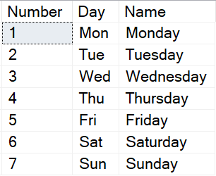
Table Variable : Example
Example
INSERT
INTO
@WeekDays
VALUES
(
1
,
'Mon'
,
'Monday'
,
)
,
Output
(
2
,
'Tue'
,
'Tuesday'
,
)
,
(
3
,
'Wed'
,
'Wednesday'
,
)
,
(
4
,
'Thu'
,
'Thursday'
,
)
,
(
5
,
'Fri'
,
'Friday'
,
)
,
(
6
,
'Sat'
,
'Saturday'
,
)
,
(
7
,
'Sun'
,
'Sunday'
,
)
;
SELECT
*
FROM
@WeekDays
;

Slide 68
Temporary Table

Slide 69
Temporary Table
Temporary tables in SQL Server are special types of tables that are stored in the tempdb database.
They can be used to store intermediate results temporarily during a session or a transaction.
Temporary Tables are Created in TempDB and are automatically deleted as soon as the last connection is terminated.
Temporary Tables helps us to store and process intermediate results.
Temporary tables are very useful when we need to store temporary data.
Types of Temporary Tables
Local Temporary Tables
Global Temporary Tables

Slide 70
Local Temporary Table
A Local Temp Table is available only for the session that has created it.
It is automatically dropped (deleted) when the connection that has created it, is closed.
To create Local Temporary Table Single “#” is used as the prefix of a table name.
Scope: This table will only exist for the duration of the session that created it.

Slide 71

Local Temporary Table
Syntax for Creating Temporary Tables
Example
CREATE TABLE #Students (id INT, name VARCHAR(25))
INSERT INTO #Students VALUES (01, 'Meet'), (02, 'Raj’)
SELECT * FROM #Students
Output
CREATE
TABLE
#TempTable
(
ColumnName1
Datatype(Size)
,
ColumnName2
Datatype(Size)
,
)
;
….

Slide 72
Drop Temporary table
While local temporary tables are dropped automatically, you can explicitly drop them using:
DROP TABLE #TempTable;

Slide 73
Global Temporary Table
To create a Global Temporary Table, add the “##” symbol before the table name.
Global Temporary Tables are visible to all connections
It is Dropped when the last connection referencing the table is closed.
Global Table Name must have a Unique Table Name.
Scope: Accessible to all sessions but removed when no session is actively using it.

Slide 74
Global Temporary Table
Syntax for Creating Temporary Tables
Example
CREATE TABLE ##Students (id INT, name VARCHAR(25))
INSERT INTO ##Students VALUES (01, 'Meet'), (02, 'Raj’)
SELECT * FROM ##Students
Output
CREATE
TABLE
##TempTable
(
ColumnName1
Datatype(Size)
,
ColumnName2
Datatype(Size)
,
)
;
….

Slide 75
Thank You

